Slide 1

Welcome to Student Complaint Management System
At Campus Concerns, we value transparency, timely action, and confidentiality in handling your complaints. Using this system, you can easily submit complaints, track their progress, and expect prompt resolutions to ensure a positive and enriching experience for all students.

Slide 2
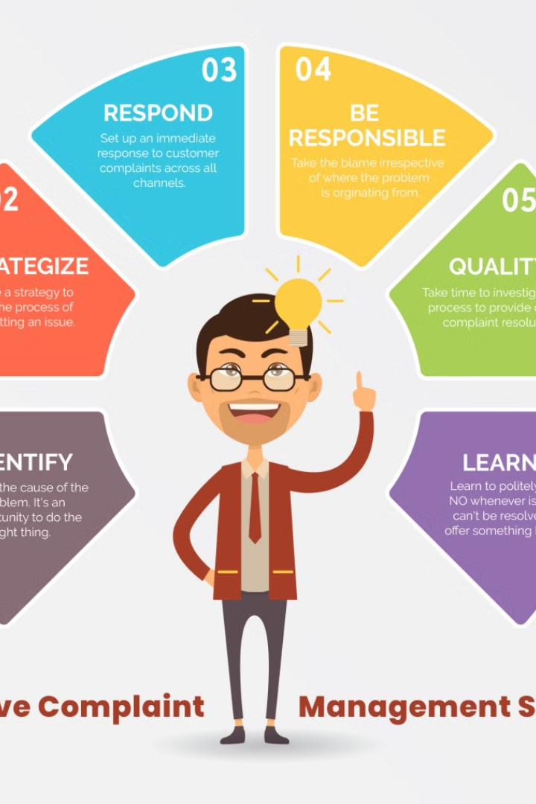

Introduction to the Campus Concerns
Welcome to Campus Concerns, your one-stop solution for managing student complaints effectively and efficiently.
Our Campus Concerns (Student complaint management system)is designed to streamline the process of reporting, tracking, and resolving complaints, ensuring a positive and transparent experience for everyone involved.

Slide 3

Purpose of the website
The purpose of our website, Campus Concerns, is to provide a seamless platform for students to report and resolve campus-related issues effectively.
We aim to promote transparency, accountability, and continuous improvement within the campus community by facilitating open communication and prompt resolution of student concerns.

Slide 4
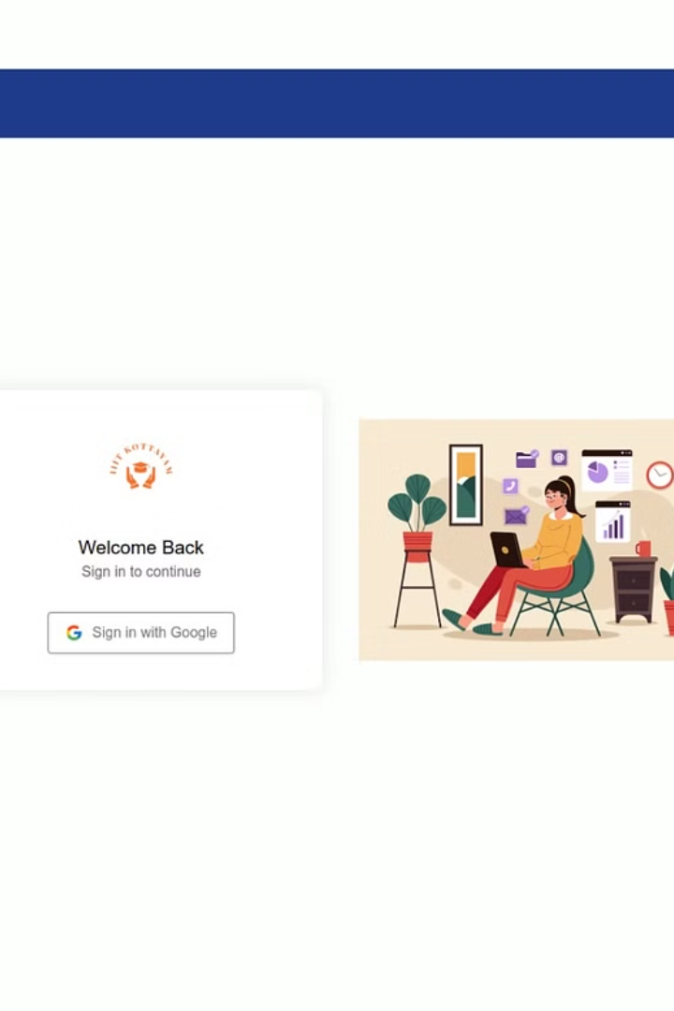
Login Page
To access the features and functionalities of Campus Concerns, please proceed to the login page. Here, you can securely enter your credentials to gain access to your personalized account, where you can submit and track your complaints in a confidential and confidential manner.
User, technician and verifiers can sign up through google where they have to enter the college email Id and the password.

Slide 5
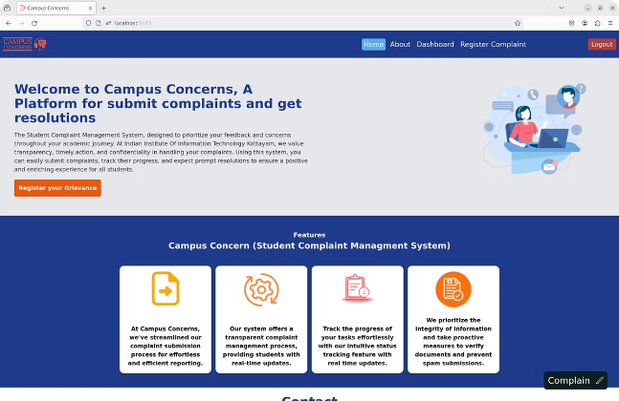
Home Page
Once logged into Campus Concerns, users will be directed to the home page where they can easily navigate through different sections of the website.
The home page provides a user-friendly interface allowing users to quickly access key features such as features,contact section.
Additionally, the home page also "Register Complaint" button where they can register there complaints.

Slide 6
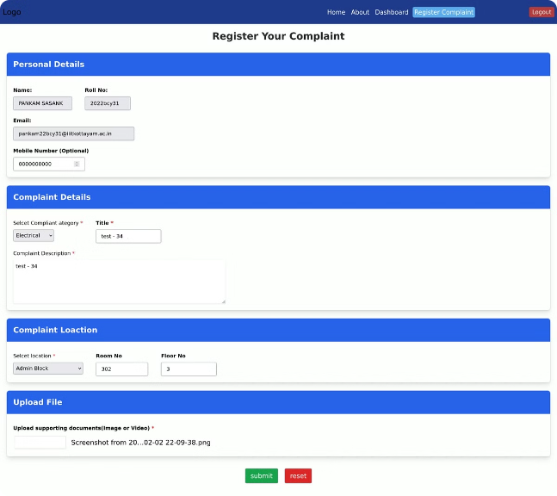
How to Register Your Complaint
Step 1: Go to the "Register Complaint“
button on the website.
Step 2: Fill in the required details such as name, contact information, and the complaint description.
Step 3: Attach any relevant documents or photos to support your complaint.
Step 4: Review the information and
submit the form.

Slide 7
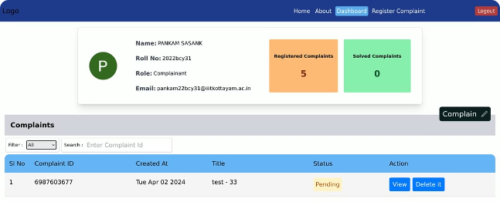
Dashboard of User
Users will be directed to their personalized dashboard where they can track the status and progress of their complaint. The dashboard will display relevant information such as the date of submission, status and actions such as deleting the complaint.
This feature additionally shows registered complaints and the solved complaints which ensures transparency and allows users to stay informed about the resolution process.

Slide 8
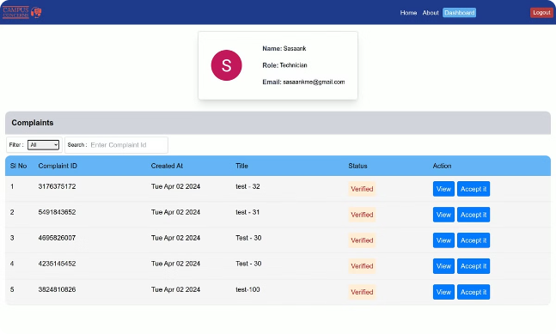
Dashboard of Technician
For technicians, the dashboard provides an overview of all assigned complaints and their current status. It also includes important details such as the date of assignment, title of assignment, and the status of the complaint. It also includes action such as view and accept the complaints.
This dashboard helps technicians effectively manage and prioritize their workload to ensure timely resolution of complaints.

Slide 9
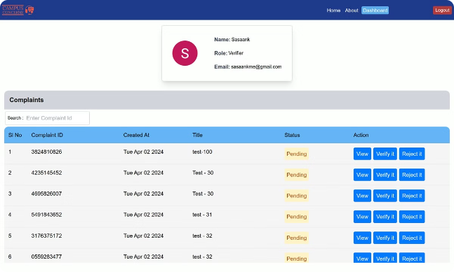
Dashboard of Verifier
The verifier's dashboard is designed to facilitate the verification process by displaying a list of pending complaints awaiting verification.
The dashboard provides key information such as the date of submission, complainant details, and a action such as view,verify it and reject it. Verifiers can easily review and take necessary actions to verify or reject the complaints as needed.

Slide 10
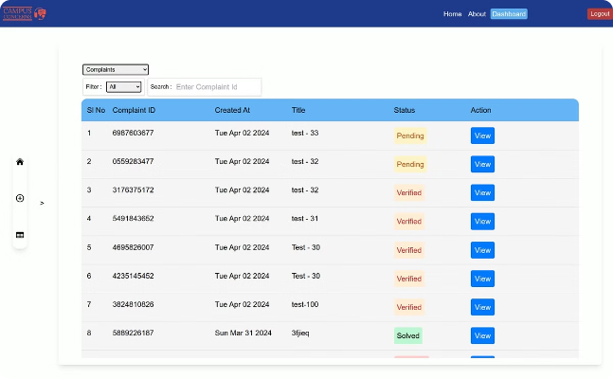
Complaint Table
The complaint table is a central component of the dashboard, displaying all the registered complaints in a tabular format. It includes important details such as the complaint ID, date of submission, complainant name, and the current status of the complaint.
The table allows users to easily sort, search, and filter complaints based on their specific requirements, improving efficiency in managing and tracking complaints.

Slide 11
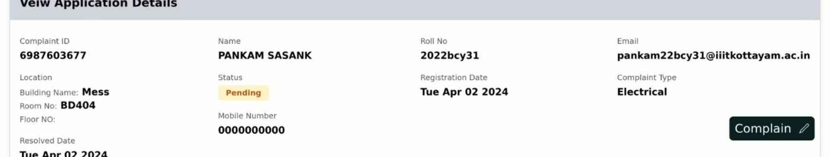
Tracking
The tracking feature allows users to track the progress of their complaints from submission to resolution. Users can see real-time updates on the status of their complaints. This provides users with transparency and peace of mind, knowing that their complaints are being actively addressed.

Slide 12

Conclusion
In conclusion, the Campus Concerns is a crucial tool for fostering a positive and harmonious campus environment.
By providing students with a platform to raise their concerns, track their progress, and receive timely resolutions.
Thank you for choosing Campus Concerns as your partner in addressing campus issues effectively.

Slide 13
Group Members:
1
Santhosh Cheemala
2
Sasank Pankam
3
A .Rahesh Sharma
2022BCY0009
2022BCY0031
2022BCY0042
4
N. Sree Divya
5
Piyush Deshpande
2022BCY0053
2022BCY0064

